Slide 1









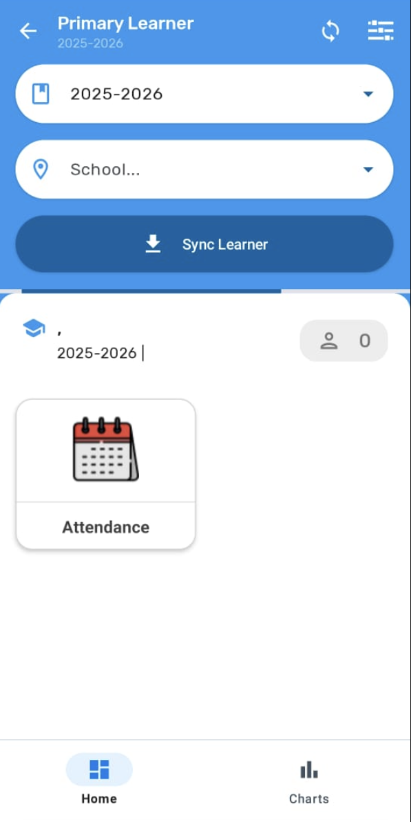
DHIS2-SEMIS
29 sept– 10 Oct 2025
Training of Trainers
How to use SEMIS Android App to register learner absences
Zero Out of School Children Project
Digital Absence Tracking System

Slide 2
Time | AGENDA | Objective
(5mins) | INTRODUCTION: | Quick introduction of participants
(15 Mins) | Session 1: Objectives of Training of Users | Participants understand the importance of SEMIS and be able to train schools on student absence tracking system.
(15 Mins) | Session 2: MINEDUC SDMS and DHIS2-SEMIS Integration | Participants understand the different components of the digital absence tracking system, from SDMS to DHIS2-SEMIS.
(15 Mins) | Session 3: SEMIS Needs and Access for DHIS2 SEMIS – Android | Participants understand what are the device and other needs for DHIS2 SEMIS and how to access the Android App
(40 Mins) | Session 4: Absence Tracking Demo- DHIS2 SEMIS ANDROID &Web | Participants understand how DHIS2 SEMIS Android is used.
(40 Mins) | Session 5: Practice on DHIS2 SEMIS Android | Participants practice on DHIS2 SEMIS Android.
(15 Mins) | Session 6: Helpdesk Support | Participants understand the Helpdesk system to report issues
(20 Mins) | Post Test | Participants take a small quiz to test their knowledge

Slide 3





Objectives
Understand the absence tracking process.
Discuss the integration of MINEDUC SDMS with DHIS2-SEMIS.
Guide participants on accessing and meeting requirements for DHIS2-SEMIS Android & Web and provide hands-on practice
Familiarize participants with Helpdesk support.

Slide 4



The connection between MINEDUC SDMS and DHIS2-SEMIS
DHIS2-SEMIS is integrated with SDMS through a backend process.
SDMS is the Upstream System
DHIS2-SEMIS is the Downstream System that reflects what is in the Upstream SDMS
What’s New
Grade, Class & Learner information in SDMS is reflected in DHIS2-SEMIS
Select Grade - shows Grade names from P1- P6
Select Class- shows existing Classes within each grade, with learners enrolled in SDMS for active AY
Fetch School, Grade, Class and learner data
MINEDUC Server for SDMS
Notes:
Always important to explain to the schools that both systems are connected, and that any action for enrolment needs to be done on SDMS by the school

Slide 5
Start of Year & Ongoing Process on SDMS
Classes are created every Academic Year (AY). Only when learners are re-enrolled, there are classes and learners for the new AY.
If learners are re-enrolled without class creation they are orphan records in a Grade.
IF any Updates are made classes and learners in SDMS, teachers should do sync config and sync data on DHIS2-SEMIS
New Learners
Transfers between Classes
Transfers between Schools

Slide 6
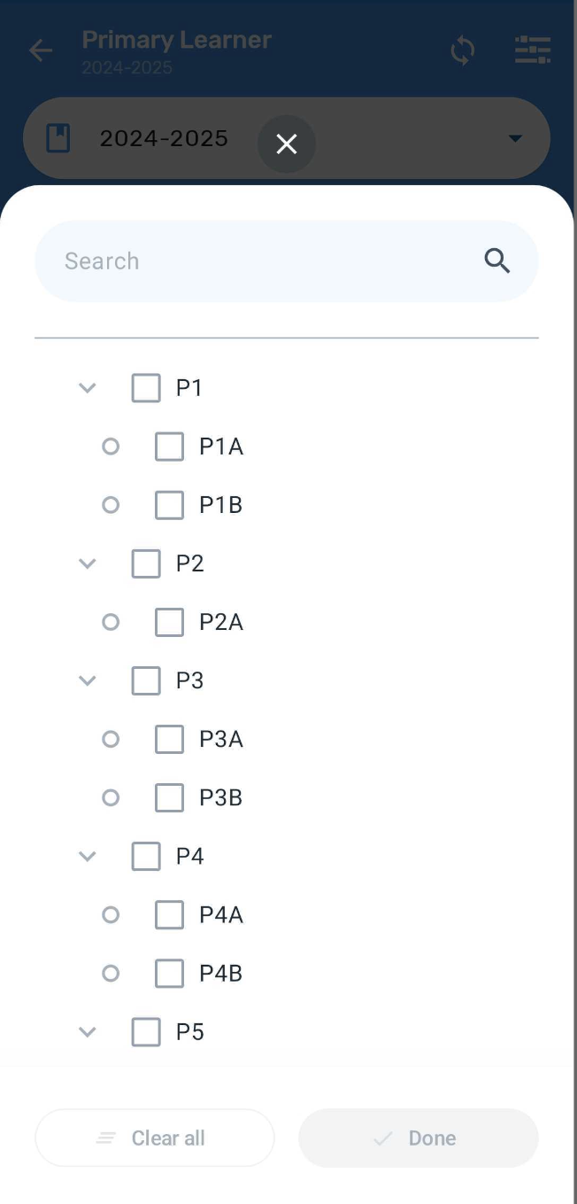
What if a Learner is not in the Correct Grade or Class or Needs Adding or Removing from a Grade or Class
If a learner is not in the correct Grade or Class OR a student is to be Added OR Removed from a Grade and Class, update the Learner List on SDMS. Follow this process:
FIRST
Class Teacher or Head Teacher informs School SDMS Focal Point to make updates in SDMS
SECOND
SDMS updates will reflect in DHIS2-SEMIS after 24 hours. If you do not see updates, press Sync Config and Sync Data
Notes:
Always important to explain to the schools that both systems are connected, and that any action for enrolment needs to be done on SDMS by the school

Slide 7

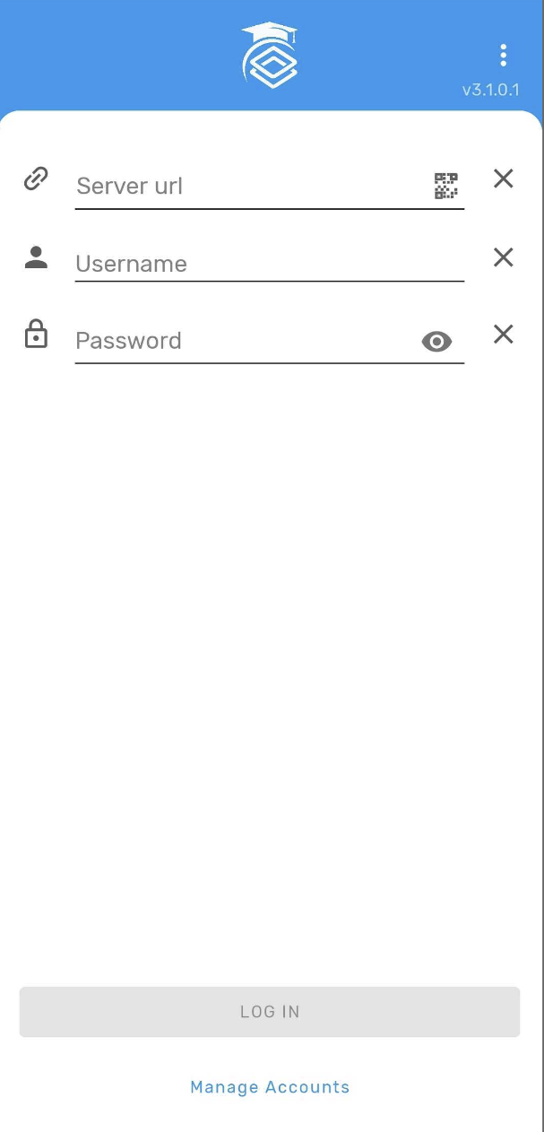
SEMIS Device & Other Needs
Technology
Android device only, NOT iPhone
Android 8 or higher
Minimum 3 GB RAM
Stable to Intermittent internet connectivity – in school or elsewhere
Mobile Data Credits or Wi-Fi for
Login
Syncing data from and to database
Sync configuration
Electricity for charging device- in school or elsewhere
Users willing to Adopt new behaviors
School Users willing to adopt new approach to digital absence tracking
Helpdesk and Support system
From ZOOSC project

Slide 8

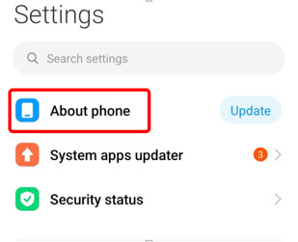
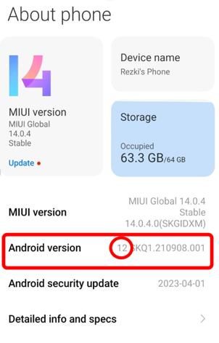
Android Version
1. Go to Settings
2. Find and tap "About phone" or "About Device"
3. Look for "Android version" or "Android version number"
← Back
Notes:
Open "Settings" on your Android device
Scroll down and tap "About phone" or "About device"
Look for "Android version" or "Android version number"

Slide 9

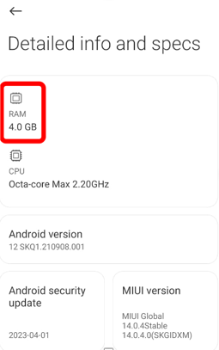
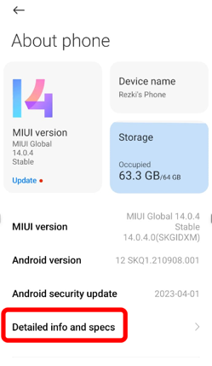
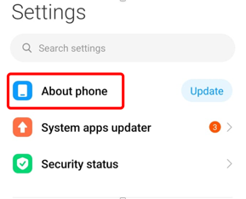
RAM Capacity
Go to "Settings"
3. Look for "Device info" or "Hardware info” or “Detailed info and specs”
4. Find "RAM" or "Memory"
2. Go to "About phone" or "About device"
← Back
Notes:
Open "Settings"
Go to "About phone" or "About device"
Look for "Device info" or "Hardware info"
Find "RAM" or "Memory"

Slide 10
How to Install DHIS2 SEMIS Android App New Version

Slide 11
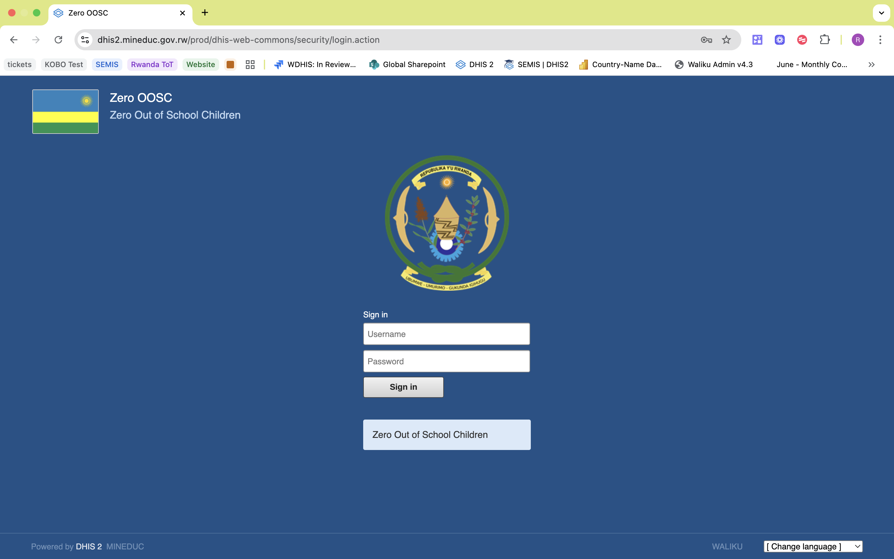

DHIS2 SEMIS Access Links
SEMIS ANDROID DOWNLOAD LINK:
SEMIS server LINK:
http://mineduc.gov.rw/semis
https://dhis2.mineduc.gov.rw/prod
App Size: 77.3 MB
This is the server with which SEMIS Android & Web sync data.

Slide 12
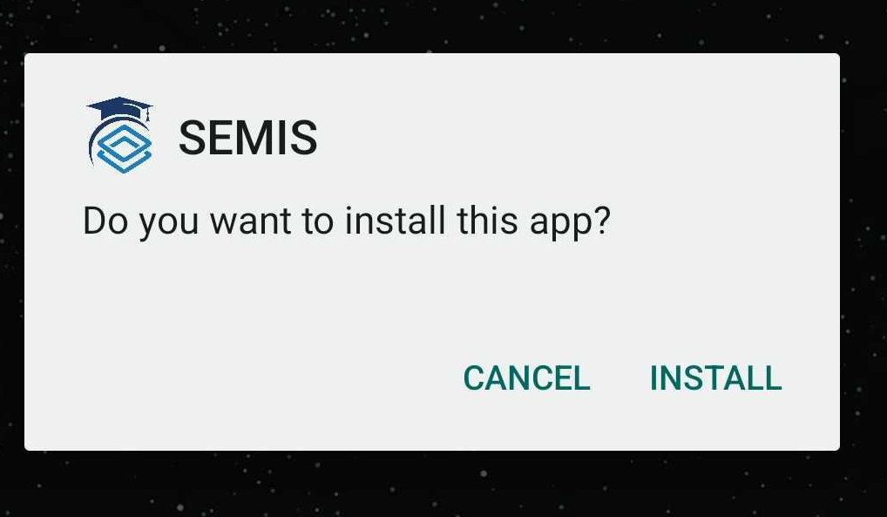
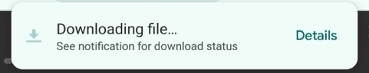
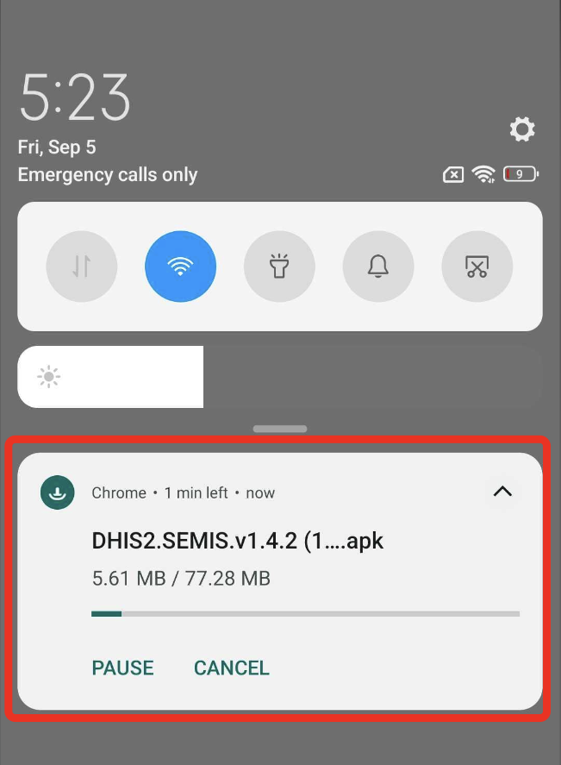
STEP 1: Install SEMIS Application
1. Go to http://mineduc.gov.rw/semis and click on download
4. Click on Install
2. Wait for the download process
3. Once downloaded, open the file by clicking on it
Note: Please note that the first-time installation may take a while, as app is 77MB so that it can store lot of school data

Slide 13
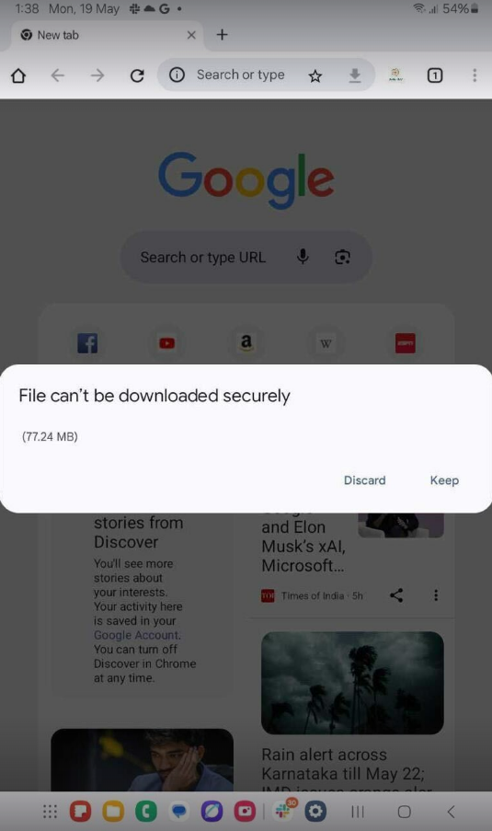
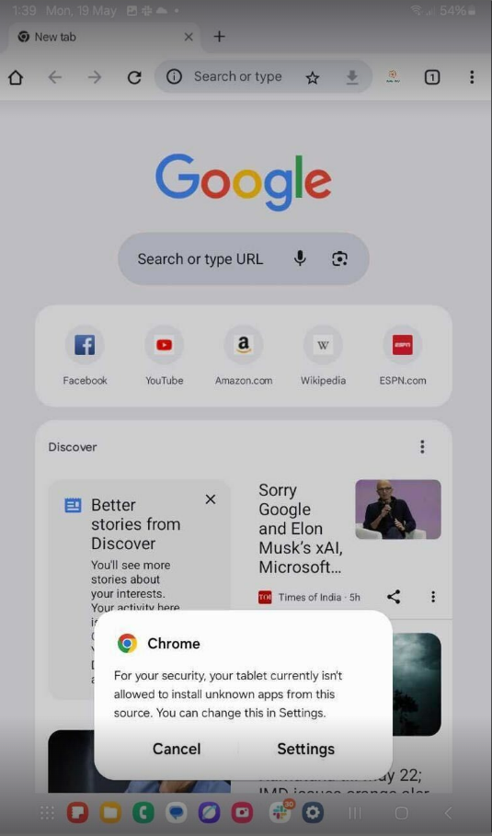
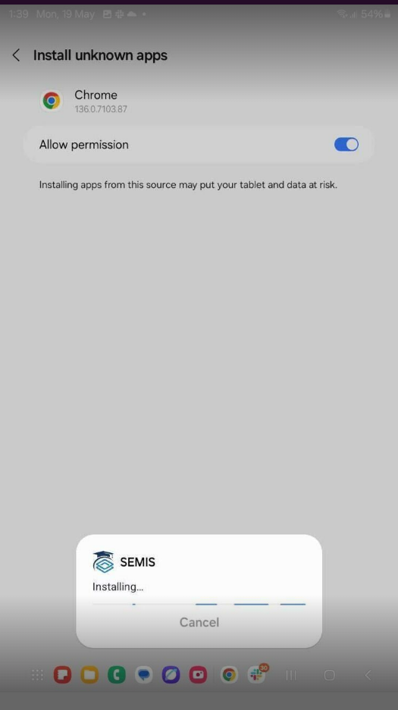
If unable to download please note on what to do to resolve the issue
Error message, click on Keep
2. With next pop up select Settings
3. Enable “Allow permission” and then go back to install the app

Slide 14
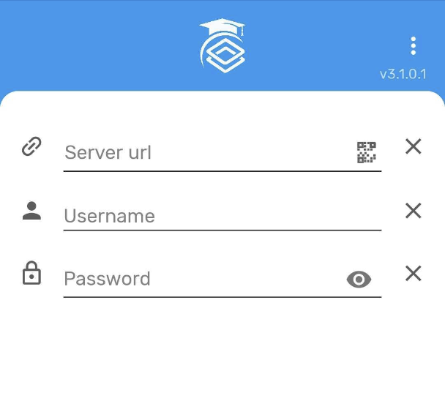

Login to the App
1. Fill in the Server Link, Username, and Password provided
3. Once Logged In, this will be the first screen that you see
2. Once done, click on Log In

Slide 15
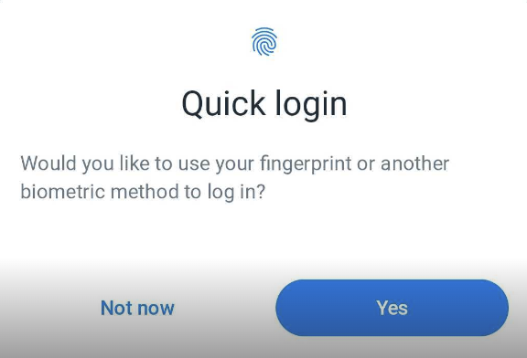
Note
Optional: Enable biometric login
After your first login, you will see a pop-up asking if you’d like to enable fingerprint or biometric login
This allows you to log in to the same school quickly next time without entering your password
Note: This only works after you log in once, and if the device supports biometrics
Keep the app logged in
You don’t need to log out after each use

Slide 16





Absence Tracking Demo & Practice DHIS2 SEMIS ANDROID

Slide 17
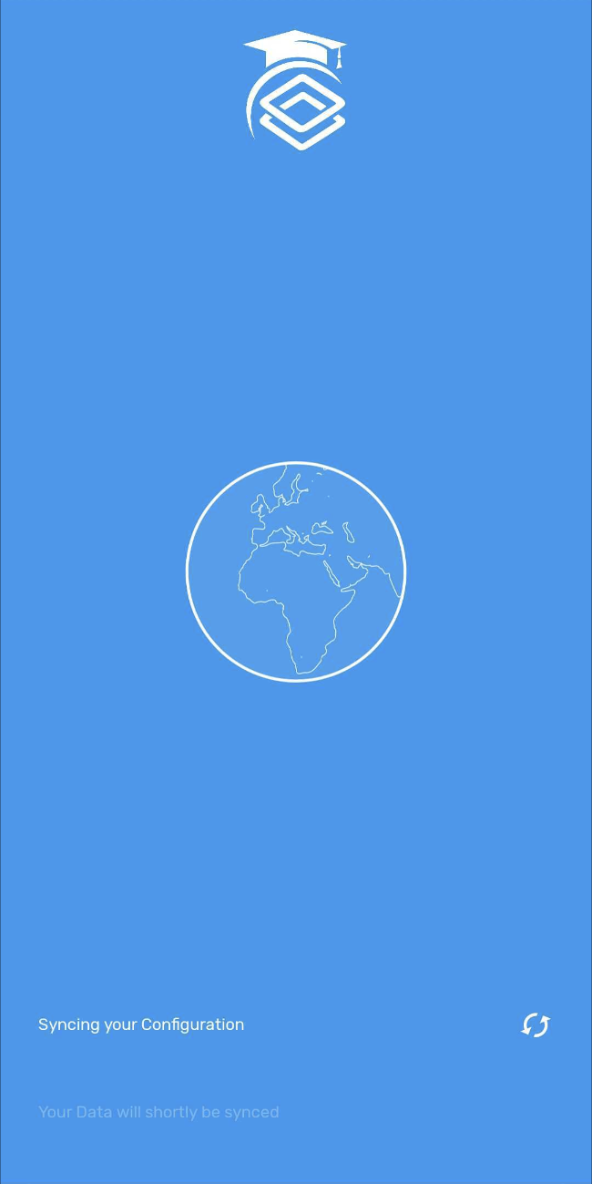
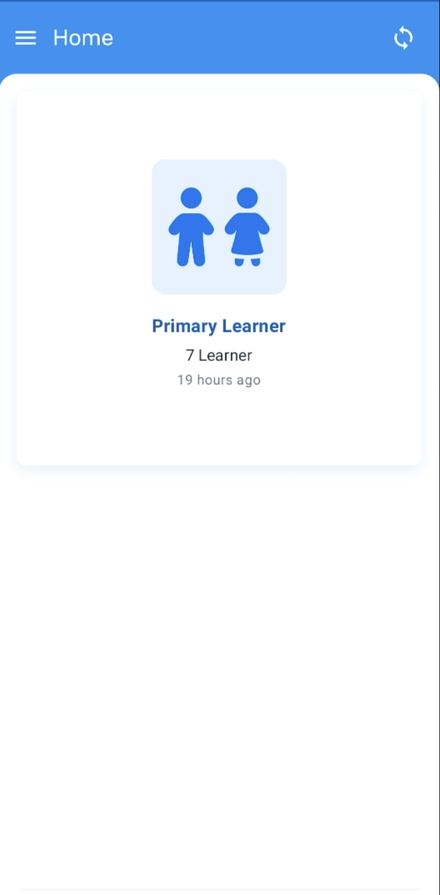
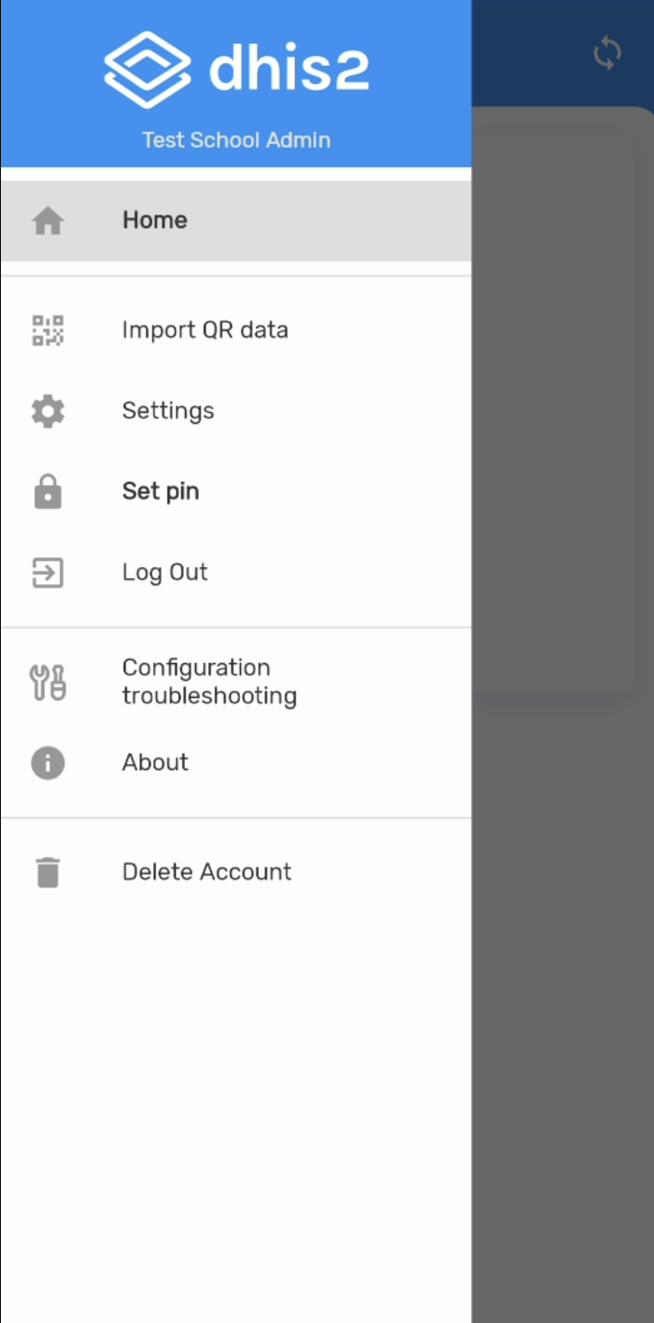
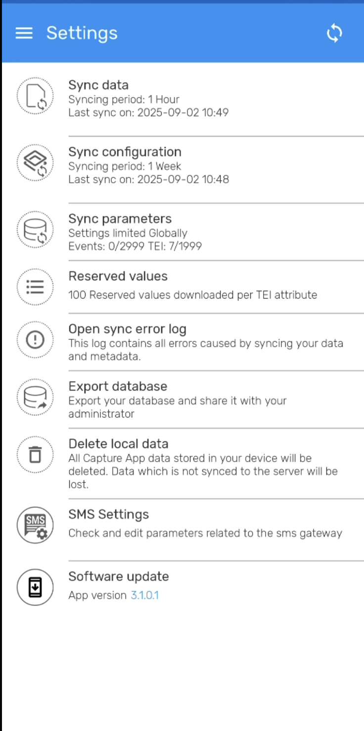
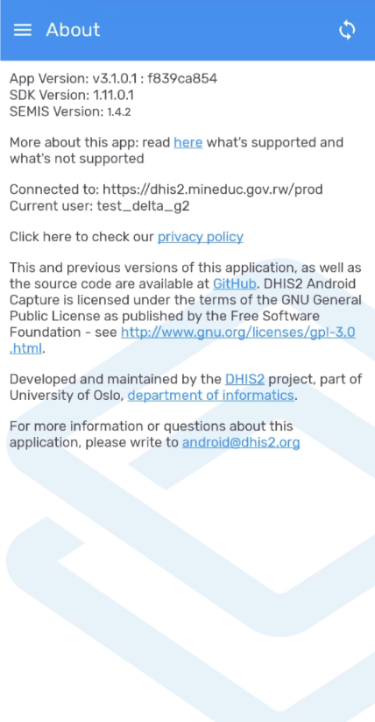
Screens That Are Blocked Due To Privacy Reason
DHIS2 Android Version
There are some screens in SEMIS Android that cannot be screen shared due to privacy reasons.
We have added those screens for your reference and also for you to use during Cascade trainings.
SEMIS Version
Click here to find out about the version

Slide 18
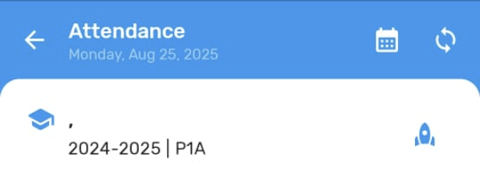
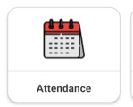
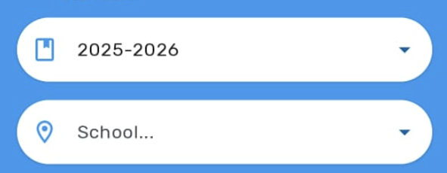
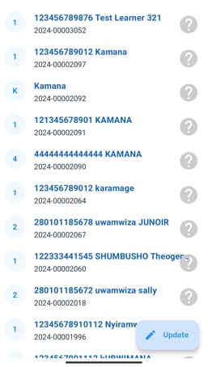
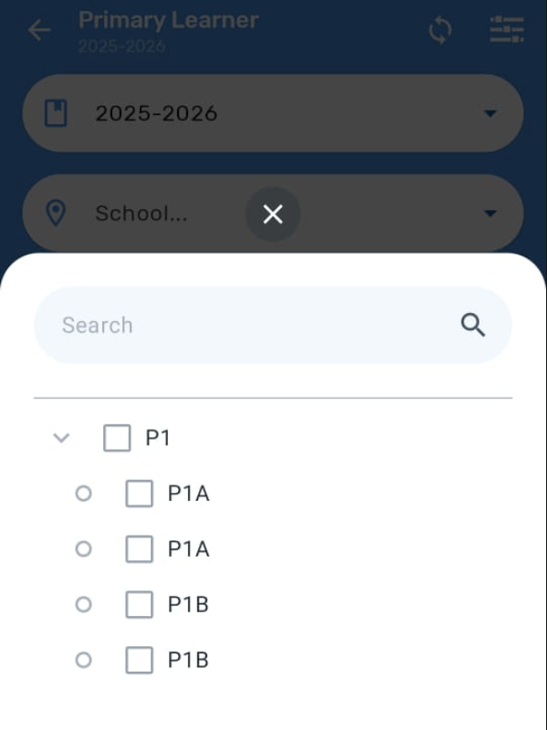
Accessing Student List
1. Select the academic cycle, then select the class
2. Click on Attendance
3. You will see list of students

Slide 19
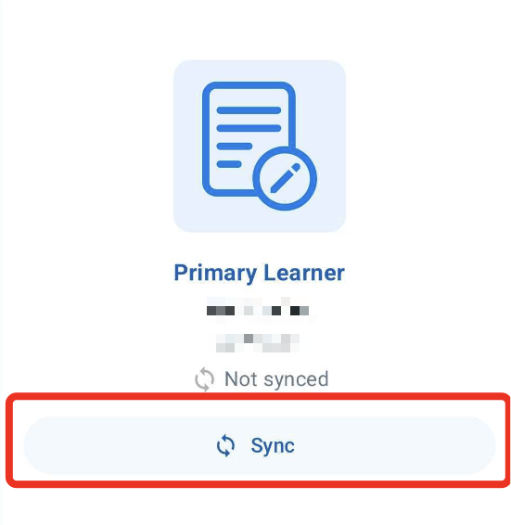


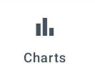
Note – Explanation on icons
This new Sync data button allows user to upload attendance data to the DHIS2 server
The Sync Learner can be ignored
The Charts feature is not functional at the moment
Same function as the main sync data button

Slide 20
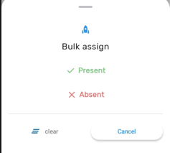
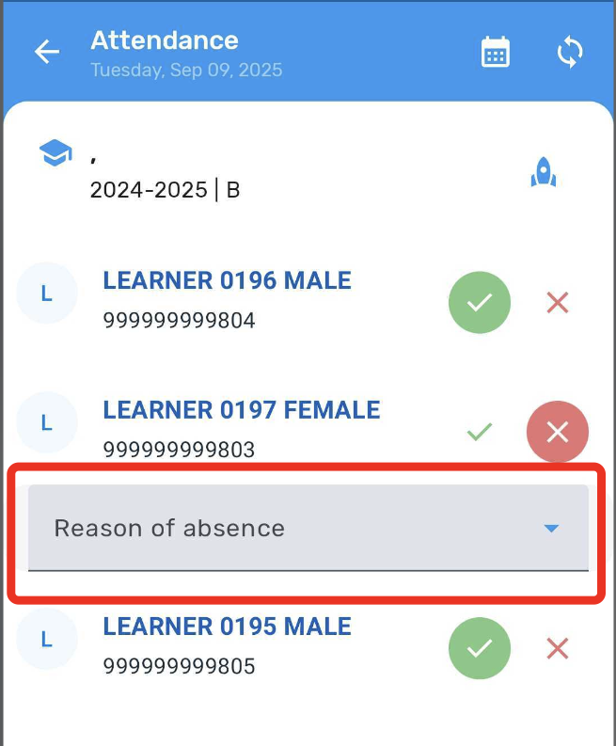
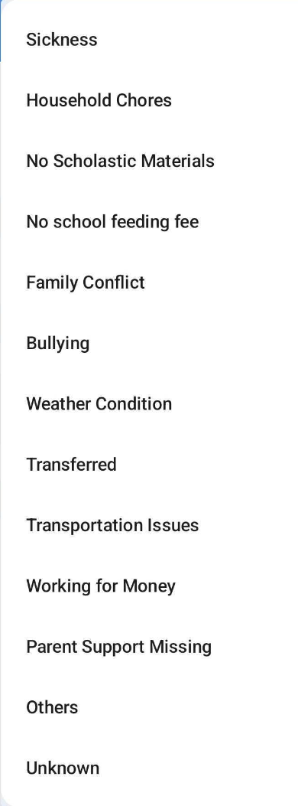

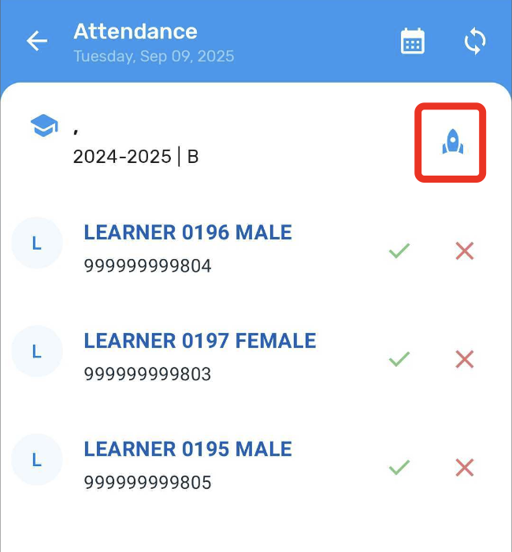
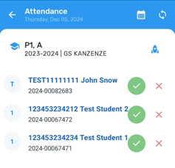
Take Attendance – Bulk Assign
A faster way to take daily attendance:
Step 1: Mark all students present first
Step 2. Select ✓ Present
Step 3. Mark absent students individually
a. Find absent students
b. Tap × for each absent student
c. Select absence reason for each student
1. Tap Update icon then tap rocket icon

Slide 21
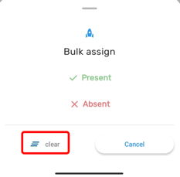
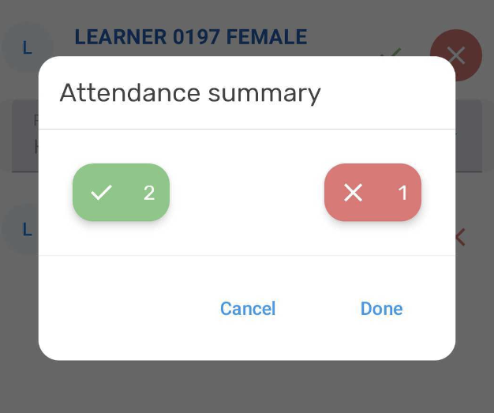
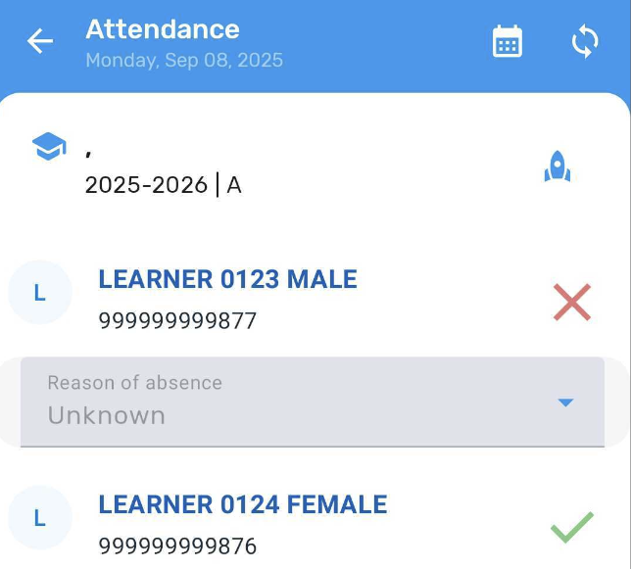
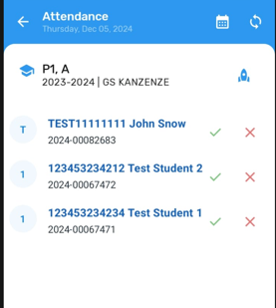
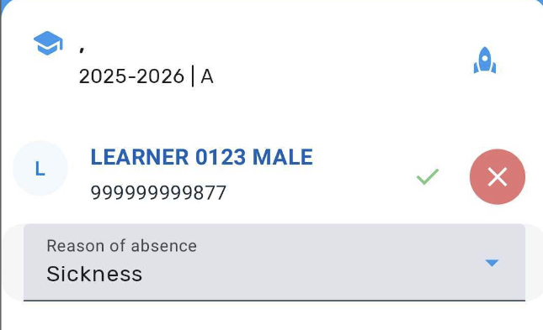

Take Attendance – Bulk Assign
Note:
For learners marked with "Unknown" as the absence reason, teachers may revisit the date and update the reason once it has been identified
Step 4: Save your attendance
1. Review all marks
2. Click Save button
2. Tap 'Clear’
3. Swipe down to reset all marks
Made a mistake? Need to start over?
1. Tap rocket icon

Slide 22
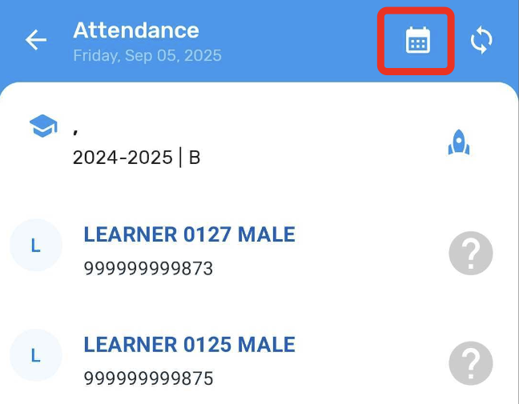
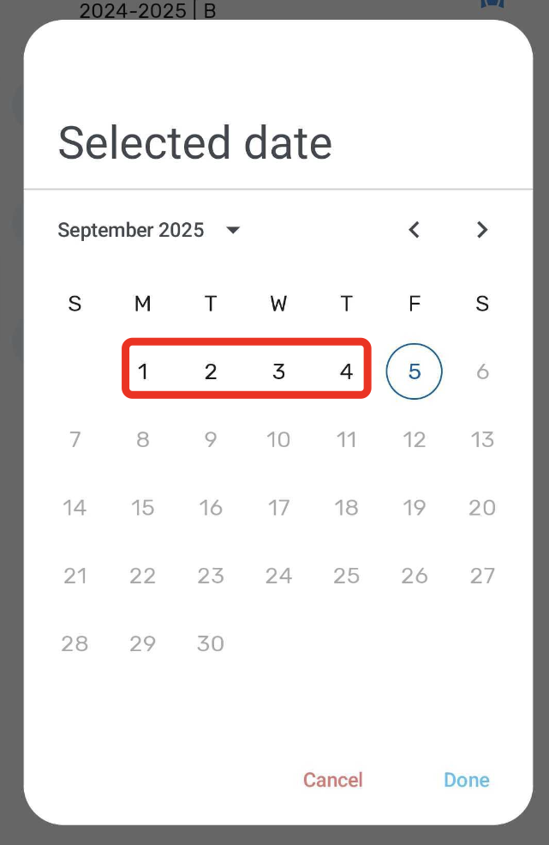
Historical Attendance
3. Record attendance for that date (including absence reasons if needed) and save it.
4. Once finished, go back to the attendance screen before selecting another date.
1. Tap the calendar icon to view dates
💡 Tip: Always return to the Attendance screen before moving to a different date.
2. Select the date you want to review or update

Slide 23

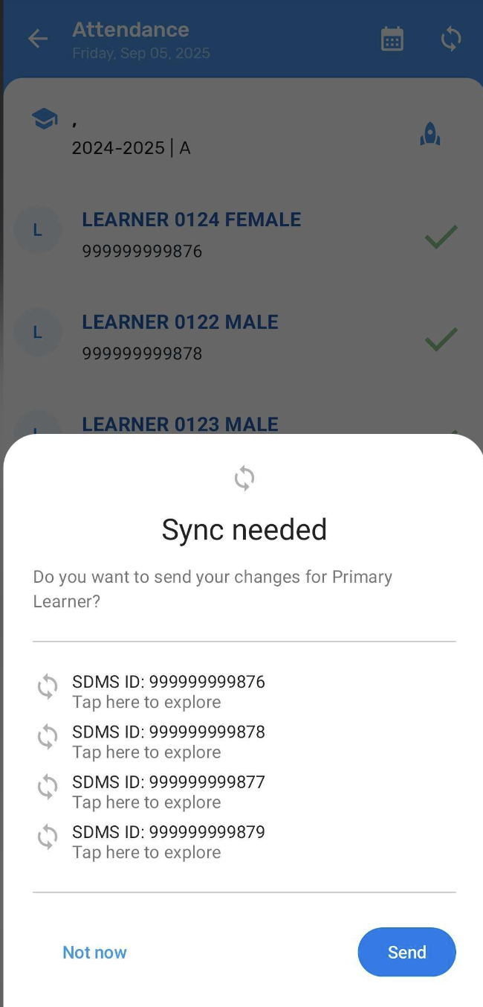

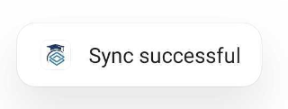

Sync Data
1. Sync Data
Refreshes learners added to the system and learner records, attendance and other dynamic data
Should run regularly to ensure the latest updates are available
Useful when new learners are added, attendance is updated or bulk changes are made
Note:
Sync data process require internet connectivity
When in doubt, sync to ensure up to date data!

Slide 24
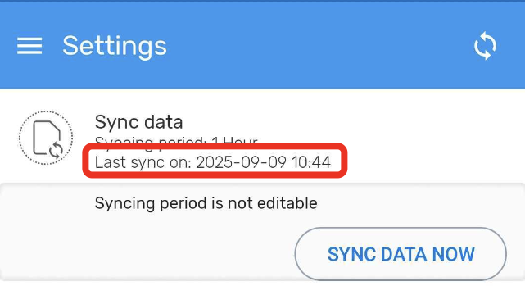
What’s different in 1.4.2 version
Passive Sync
How to verify (each test run):
Note the Last Sync Data time in Settings (e.g. 10:44)
Wait for Next Sync in one hour (e.g. 11:44 for 1 hour)
Notes:
Notes:
If a tester sees “Sync finished but we did not receive server confirmation…”, retry sync and capture time/device details
If the interval change doesn’t take effect, the user likely didn’t Sync Configurations after installing

Slide 25
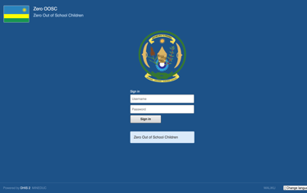
Bulk Absence Tracking from SEMIS Web App

Slide 26
SEMIS WEB
SEMIS Web App Link:
https://dhis2.mineduc.gov.rw/prod/
Tutorial Links
SEMIS Web App
Bulk Import Student Attendance: https://youtu.be/d_yth9AqPQ
Notes:
Single Attendance: https://youtu.be/d_ythx5DqTQ?si=I5nWL2K6hbHUKbmS

Slide 27
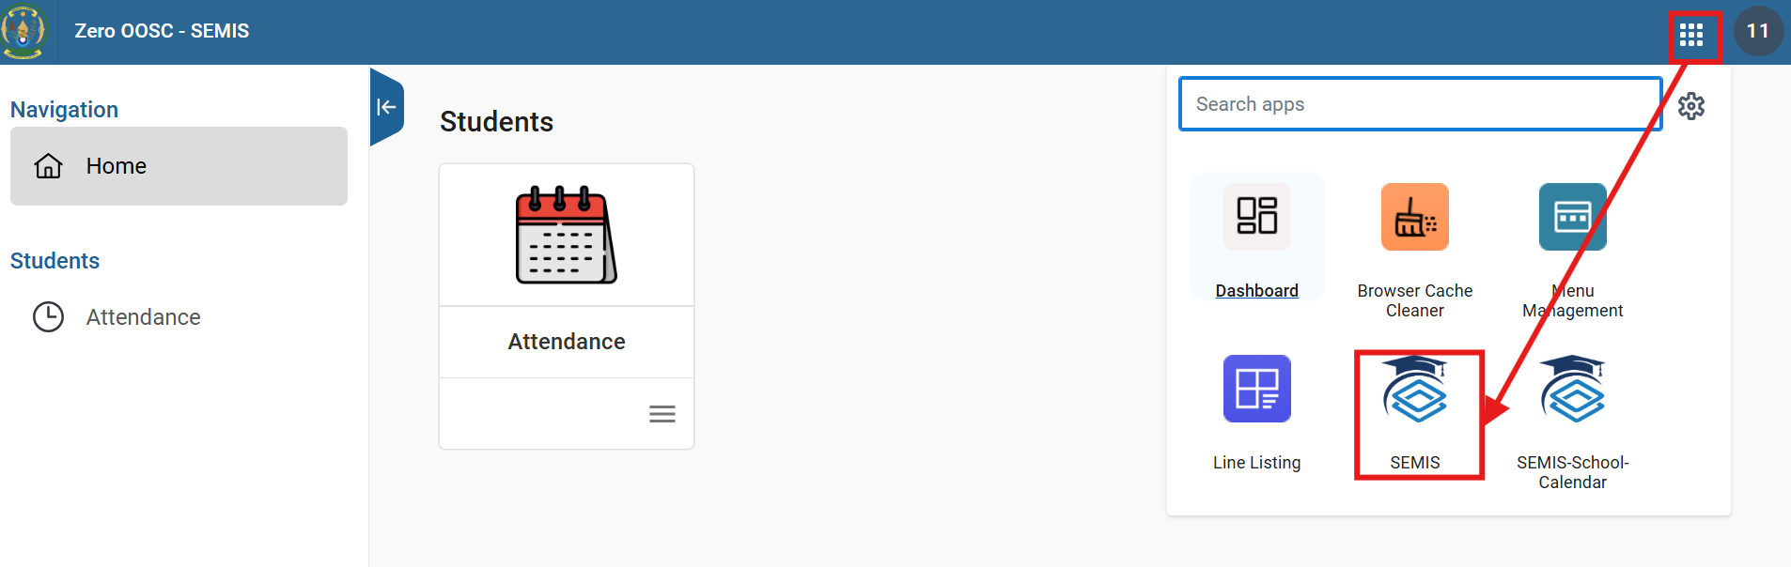
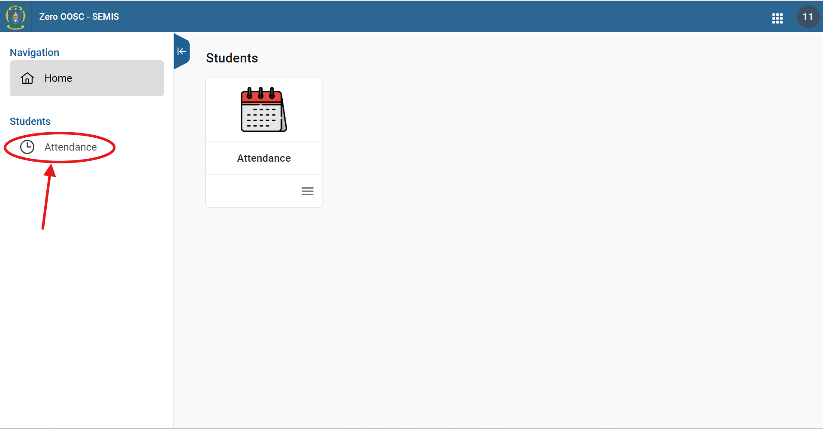
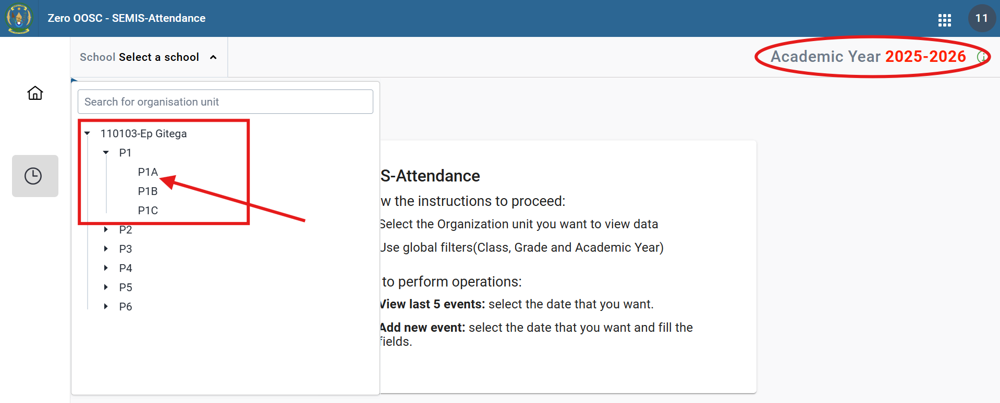
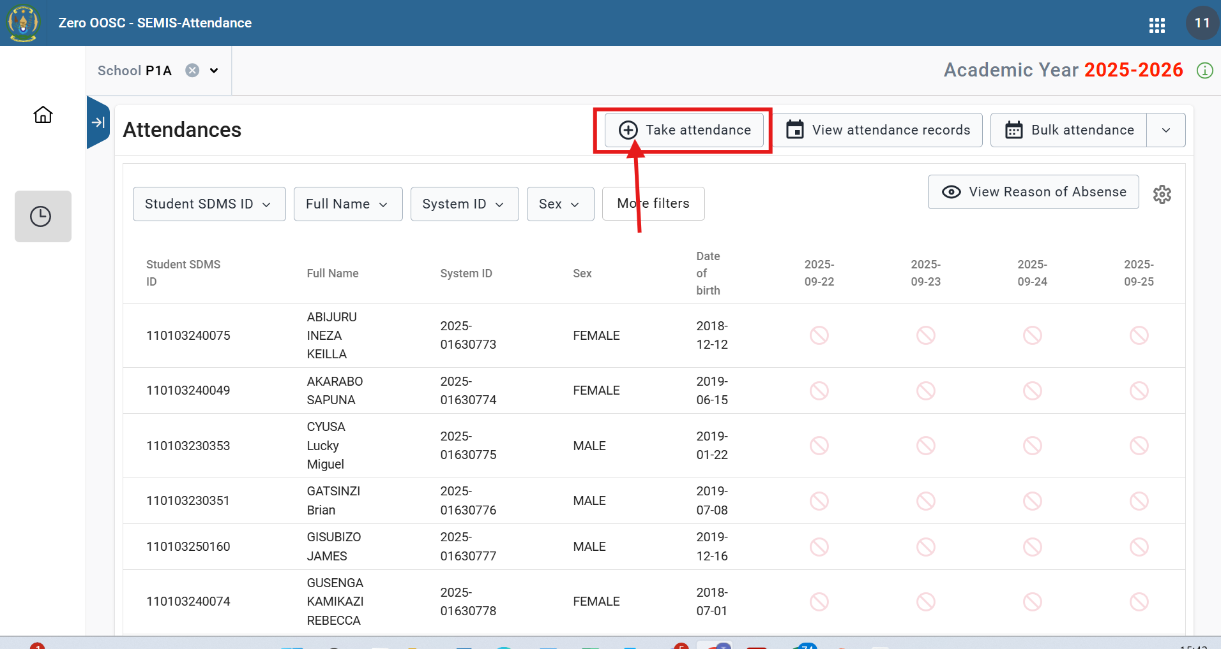
How to take attendance on SEMIS Web
1. After Loging In, click that 9 point box and select SEMIS
2. cIick on attendance
3. Select academic year 2025-2026 and select class
4. Click take attendance and choose date
Notes:
trainingschool2_sa
Rwanda2025!

Slide 28
Helpdesk configuration and problem/error reporting
Support Hierarchy:
Level 1 Day-to-day: User who are confident with the app support others in the school. This is the first line of support after Training.
Communication channel: Verbal between school staff, WhatsApp
Level 2 Local Remote Support from District Officials. Reach the District Officials (DPO/DO) if you cannot solve the issue yourself. Explain the problems you are facing and any screenshots or recording of the problems.
Communication channel:
WhatsApp
Phone call

Slide 29

Level 2 Helpdesk
WhatsApp Group – A circle of user support
WhatsApp groups between District Officials and each school can help report issues and enable faster feedback, and resolution of issues.
REMEMBER TO CREATE WhatsApp GROUP DURING CATEGORY 3 TRAINING
Reporting of Issues
Username and password of the user to be mentioned facing the issue
Share videos or screenshots

Slide 30
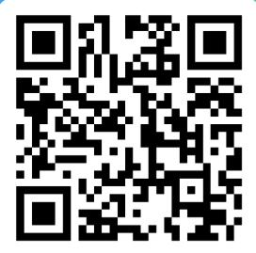
POST TEST!
School Post Test
https://odk.mineduc.gov.rw/-/single/gGbhxdVZXtKPT3ZRtfs7nb2MKQKORYR?st=IyY9p6T8LISsjWvzYyxl8eD6thNd7eLKaWxA30j7BtlkBvgpjoKYD$8XubL5veKv
Project Post Test: https://forms.office.com/e/PNYUU6gPLe

Slide 31
Thank You!

